Slide 1
CE888-7-SP Data Science and Decision Making project
registration number :2323135

Slide 2
The project is about giving local people access to free energy when there will be surplus in energy ( either wind or solar energy)
To do this, I will develop a system which can predict the surplus of energy enabling me checking the feasibility of this plan.

Slide 3

What is the aim of the project? The aim of this project is to predict 24 hours in advance if there will be surplus energy. Why? To send out an alert to the customers in the area to allow them to opt-in to the slot.
What am I doing?
What I am doing is taking the data set that was given to me by the company.
What is the data set?
It is historic records in the area from 2010 until now for Briton city.
What type of energy was chosen?
Solarradation energy.
This Photo by Unknown Author is licensed under CC BY-SA-NC

Slide 4
Assumptions for calculating the threshold ‘above this threshold we can offer free energy because we will have surplus of energy’: 1-number of houses = 500 house 2-energy per hour per hour = 0.5 3-the changes of people behaviour = 3 times threshold = maltiplying the three component above assuming that the annualy consumption of electricity per house per family is 0.5 kwh
Assumptions for calculating the solar panels energy, which can be calculated from ‘E = A*R*H*PR ‘:
1- area for the solar panels= 1.5 meter
2- efficiency = 0.5
3- performance = 0.7
For calculating the energy, we multiple all the previous component with the hourly predicted value of solarradation h.
I will assume that the company has 200 solar panels to generate electricity.

Slide 5

Methods: 1-the input: the historic data I choose to work on ‘solarradation column’. 2-The out put: the amount of surplus energy available in the next 24 hour, ‘Every hour’. 3-modelling: baseline machine learning ‘huber()’ .
Breif explanation about my work:
First of all, I divided my data set to train validation and test. The first 9 yeas train the next 4 for validation and the remaining data for testing.
I used two models baseline and machine learning.
Why I used baseline?
Because I want to make sure that my machine learning model give a better prediction. For the baseline I used the previous four years from traning and compared it with my validation set then getting the MAE.
for the machine learning I took window size of 24 to predict the next 24 hour.

Slide 6
Result : the threshold = 500* 0.5* 3 = 750 kwh/m2 ‘if the energy generated is less than that we cannot offer local people free energy otherwise if the company will offer under the threshold that will cost the company money’.
False positive
It is extremely important for preventing losing money by offering people energy when there is no free energy.
How we prevent that?
I will take the amount of solarradation that is predicted every hour and subtract the MAE ‘the error’. In tis way I can reduce the consequences of if my prediction was different from what will happen in the reality. I will make comparison in the next slide.

Slide 7
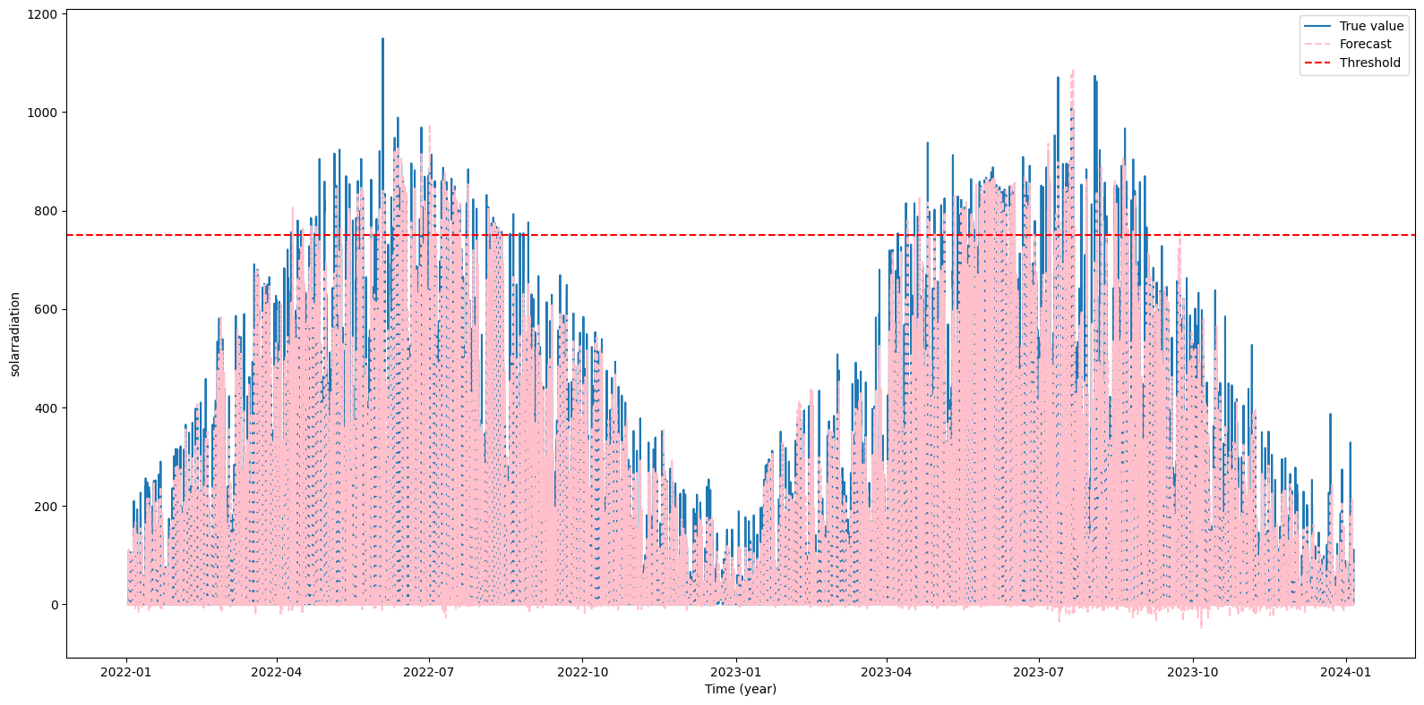
This figure shows the predicted amount of solarradation absorbed or reached by solar panels, the actual value and the threshold.

Slide 8
Hourly Predicted energy
Before considering the false positive
After considering the false positive to reduce the risk
Energy =(area* efficiency* [predicted amount of solarradation every hour – mean average error] * performance)* number of solar panels
Hour 12 = 101-53 then the energy is (1.5 * 0.5 * 48 *0.7)*200= 4300 > 750 surplus
Hour 13 = 130 -53 then the energy is (1.5 * 0.5 * 77 *0.7)*200 = 7700 > 750 surplus
Hour 14 = 90 -53 then the energy is (1.5 * 0.5 * 37 *0.7)*200 = 3800 > 750 surplus
Hour 15 = 26 -53 then the energy is (1.5 * 0.5 * -27 *0.7) *200=- 0> 750 no surplus
Hour 16 = 5 -53 then the energy is (1.5 * 0.5 * 48 *0.7)*200 = 0< 750 no surplus
Hour 18 to Hour 7 the amount of solarradation absorbed is 0 and that is because there is no sun.
Hour 8 = 6 -53 then the energy is (1.5 * 0.5 * -47 *0.7)*200 = 600 < 750 no surplus
Hour 9 = 27 -53 then the energy is (1.5 * 0.5 * -26 *0.7)*200 = 0 > 750 no surplus
Hour 10 = 75 -53 then the energy is (1.5 * 0.5 * 22 *0.7)*200 = 0 > 750 no surplus
Hour 11 = 128 -53 then the energy is (1.5 * 0.5 * 75 *0.7)*200 = 7500 > 750 surplus
all the numbers are approximated because I assume it is okay because the all previous number are also made from my assumptions
Energy = (area* efficiency* predicted amount of solarradation every hour* performance)* number of solar panels
Hour 12 = 101 then the energy is (1.5 * 0.5 * 101 *0.7)*200= 10600 > 750 surplus
Hour 13 = 130 then the energy is (1.5 * 0.5 * 130 *0.7)*200 = 13600 > 750 surplus
Hour 14 = 90 then the energy is (1.5 * 0.5 * 90 *0.7)*200 = 9400 > 750 surplus
Hour 15 = 26 then the energy is (1.5 * 0.5 * 26 *0.7) *200= 2600 > 750 surplus
Hour 16 = 5 then the energy is (1.5 * 0.5 * 5 *0.7)*200 = 600 < 750 no surplus
Hour 17 = 130 then the energy is (1.5 * 0.5 * 130 *0.7)*200 = 100 < 750 no surplus
Hour 18 to Hour 7 the amount of solarradation absorbed is 0 and that is because there is no sun.
Hour 8 = 6 then the energy is (1.5 * 0.5 * 6 *0.7)*200 = 600 < 750 no surplus
Hour 9 = 27 then the energy is (1.5 * 0.5 * 27 *0.7)*200 = 2600 > 750 surplus
Hour 10 = 75 then the energy is (1.5 * 0.5 * 75 *0.7)*200 = 7800 > 750 surplus
Hour 11 = 128 then the energy is (1.5 * 0.5 * 128 *0.7)*200 = 13200 > 750 surplus
all the numbers are approximated because I assume it is okay because the all previous number are also made from my assumptions

Slide 9
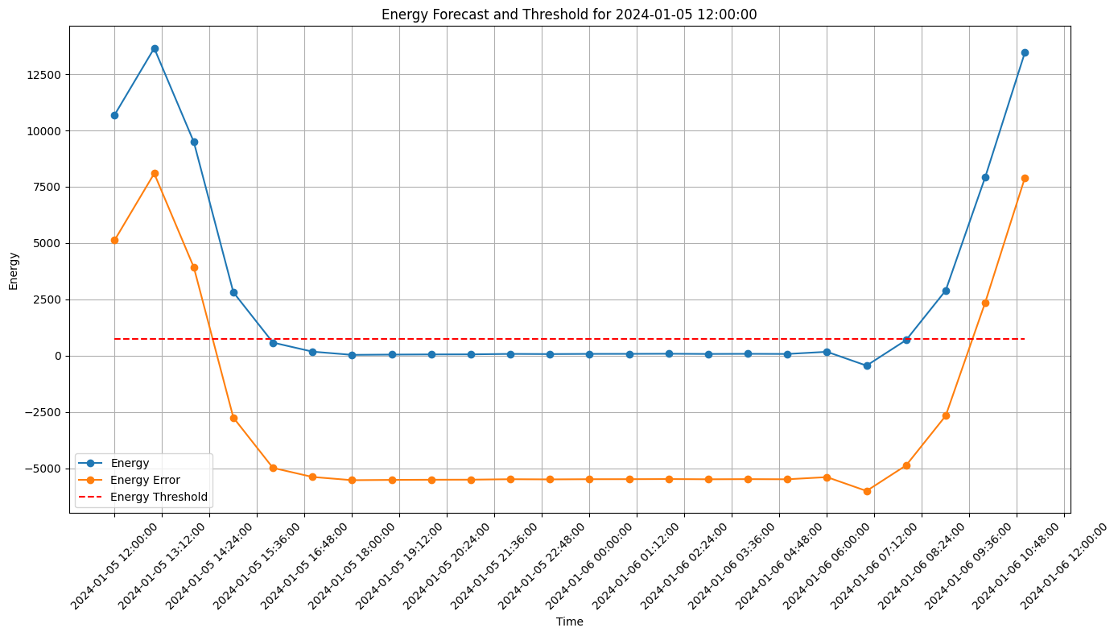
So, to sum up what I have demonstrate in the previous slides before considering the false positive I decide that there is seven hours had surplus energy and the company can apply this plan. However, after taking false positive in consideration I decided that there is just 3 hours of surplus energy the company can offer free energy in this specific hours. I will illustrate the plot
This plot shows the predicted energy per hour and the predicted energy after and before false positive

Slide 10
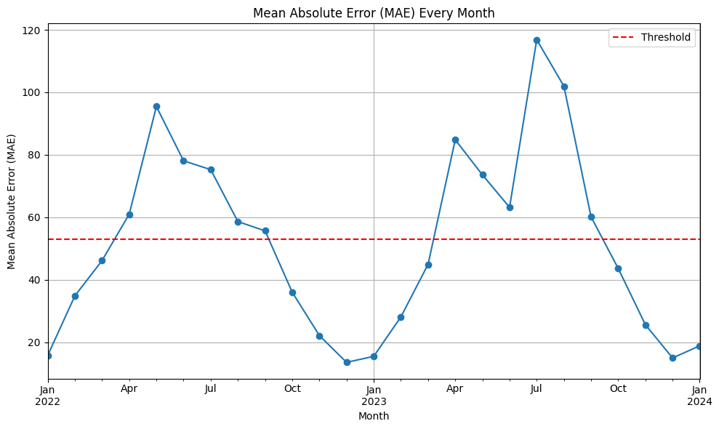
In this plot which demonstrate the mae over time from 2022 to 2024, we can understand that from January to approximately middle of march there is no enough surplus energy which correspond to low mea and from middle of march to approximately September there is a high amount of surplus energy which indicated by high mea. And that would be explained that usually in these months there is more solarradation and sun stay for longer hours. Therefore, I recommend implementing this plan based on all previous plots and calculation. I recommend implementing this plan from first April to the first of September taking in consideration the hour of the day as well as false positive .

Slide 11
References [Wind Resource and Wind Power Generation Assessment for Education in Engineering](https://www.mdpi.com/2071-1050/13/5/2444) [Calculation of electrical energy with solar power plant design](https://ieeexplore.ieee.org/abstract/document/7828701) [Efficiency improvement for solar cells panels by cooling](https://ieeexplore.ieee.org/abstract/document/8724625) [Energy consumption in UK households: Impact of domestic electrical appliances](https://www.sciencedirect.com/science/article/pii/0306261996000013)

